Slide 1
DATA STRUCTURES

Slide 2
Outline
Primitive Types
Arrays
Tuples
Strings (in details)
Linked Lists
Stacks and Queues
Binary Trees
Heaps
Hash Tables
Binary Search Tree
Graphs

Slide 3
Reminder: Primitive types
Integer: int
Floating point number: float
Boolean: bool
Character/String: string*
Object: object**
* Some languages have separate types, char and string. Python only has string. **an object is usually a number of primitive types grouped together.
Notes:
We should note int type is not bounded in Python (in other languages it's bounded)

Slide 4
Numbers: integers and floats.
age = 25 > type(age) == int weight_kg = 60.75 > type(weight_kg) == float ratio = 25 / 10 > type(ratio) == float (in Python 3!)

Slide 5
Booleans
is_infected = False is_healthy = not is_infected > is_healthy == True height_cm = 176 weight_kg = 34928043 invalid_entry = (height_cm > 300) or (weight_kg > 1000) > invalid_entry == False or True > invalid_entry == True

Slide 6
Characters and strings
first_name = ‘Abdelmoula’ last_name = “Bennis Bensouda” # note: no difference between ‘ and “. full_name = f‘{first_name} {last_name}’ # in older versions: # full_name = ‘%s %s’ % (first_name, last_name) full_name.replace(“Ben”, “Bou”) == “Abdelmoula Bounis Bousouda” character = “c”

Slide 7
Numbers: integers and floats.
age = 25 type(age) == int weight_kg = 60.75 type(weight_kg) == float

Slide 8
Arrays (list)

Slide 9
Arrays
my_array = []
0
2
4
6
8
10
for i in range(6): my_array.append(i*2)

Slide 10
Arrays
my_array[2] == 4 # O(1) del my_array[3] # O(n) my_array.pop(3) # O(n) my_array.index(10) # O(n)
0
2
4
6
8
10

Slide 11
Arrays
مهم لخزن مجموعة من القيم.
contiguous block of memory
O(1) random access.
O(n) deletion.
O(n) search.
0
2
4
6
8
10

Slide 12
Python list type operations
Instantiating a list إنشاء قائمة
> L = [1,3,5,2] > L = [1,3] + [5,2] > L = [0] * 10 > L = list(range(100)) > list comprehension
Instantiate a 2D array: [ [1,2,4], [3,5,7,9], [13]]
Basic operations:
> len(L), L.append(42), L.remove(2), L.insert(3, 28)

Slide 13
Python list type operations
Checking is a value x is present in a list L:
x in L # (O(n) time complexity)
Basic methods for lists:
min(L), max(L)
L.reverse() # (in place)
reversed(L) # (returns a new object)
L.sort() # (in place)
sorted(L) # (returns a copy)
del L[i] # (deletes the element of index i)
del L[i:j] # (removes the slice)

Slide 14
In place operations vs Creating a new object
In place
> L1 = [2, 4, 5, 1, 3] > L1.sort() > print(L1) [1, 2, 3, 4, 5]
Creating a new object
> L1 = [2, 4, 5, 1, 3] > L2 = sorted(L1) > print(L1) [2, 4, 5, 1, 3] > print(L2) [1, 2, 3, 4, 5]

Slide 15
Slicing
Usage: A [start : end : step] (`end` is excluded, taking elements each `step`)
Examples:
A = [1, 6, 3, 4, 5, 2, 7] ^ ^ ^ ^ ^ ^ ^ index: 0, 1, 2, 3, 4, 5, 6
A[ 2 : 4] is [3, 4] # start = 2, end = 4, step = 1 <=> A[2:4:1]
A[2 : ] is [3, 4, 5, 2, 7] # start = 2, end = len(A), step = 1 <=> A[2:7:1]
A[ : 4] is [1, 6, 3, 4] # start = 0, end = 4, step = 1 <=> A[0:4:1]
A[ : -1] is [1, 6, 3, 4, 5, 2] # start = 0, end = len(A)-1, step = 1 <=> A[0:6:1]
A[-3 : ] is [5, 2, 7] # start = len(A) - 3, end = len(A), step = 1
A[-3 : -1] is [5, 2] # start = len(A) - 3, end = len(A) - 1, step = 1
A[1: 5: 2] is [6, 4] # start = 1, end = 5, step = 2
A[5: 1: -2] is [2, 4] # start = 5, end = 1, step = -2
A[ : : -1] is [7, 2, 5, 4, 3, 6, 1] # reverse a list

Slide 16
Tuple
يشبه Tuple إلى حد كبير نوع List ، مع وجود قيود على أنه غير قابل للتغيير.
> tuple1 = (0, 1, 2, 3) > tuple2 = ('Ahmed', 'Ayoub', 'Hamza') > print(tuple1 + tuple2) (0, 1, 2, 3, 'Ahmed', 'Ayoub', 'Hamza')
> tuple1[0] = 4
Traceback (most recent call last): File "test.py", line 3, in tuple1[0]=4 TypeError: 'tuple' object does not support item assignment

Slide 17
Strings
special kind of array made out of characters.
> s = 'abcde' > print(s[0]) 'a'
> print(len(s)) 5
> s = s + 'f' > print(s) 'abcdef'
> print( s [ 2 : 4] )
'cd'

Slide 18
Strings library
s = " abcde "
'ab' in s # True
s.strip() # s = 'abcde'
s.startswith('ab') # True
s.endswith('de') # True
"Ayoub, Ahmed, Hamza".split(',') # ['Ayoub', 'Ahmed', 'Hamza']
3 * 'ab' # 'ababab'
', '.join(['Ayoub', 'Ahmed', 'Hamza']) # "Ayoub, Ahmed, Hamza"
'Aa'.lower() # 'aa'
'Name {name}, Rank {rank}' .format(name='Archimedes', rank=3)

Slide 19
Linked Lists
class ListNode:
def __init__(self , data=0, next_node=None): self.data = data
self.next = next_node
L
2
5
3
None

Slide 20
Linked Lists
 | Arrays | Linked Lists
Insertion | O(n) | O(1)
Deletion | O(n) | O(1)
Lookup kth element | O(1) | O(k)
Search | O(n) | O(n)
L
2
5
3
None

Slide 21
Search for a key
def search_list (L, key):
while L and L.data != key:
L = L.next
return L
Example:
search_list(L, 3)
L
2
5
3
None
L = L.next
L
5
3
None
L = L.next
L
3
None

Slide 22
Insert a new node after a specified node
def insert_after(node, new_node):
new_node.next = node.next
node.next = new_node
X
node
5
3
None
X
new_node
4
None

Slide 23
Delete a node
def delete_after(node) :
if node.next is not None:
node.next = node.next.next
X
node
5
3
None

Slide 24
Go to Colab!

Slide 25
Stacks

Slide 26
Stack in action
stack.push(24)
stack.push(5)
stack.push(12)
12
top
stack.peek()
> 12
5
stack.pop()
> 12
top
24
stack.pop()
> 5
top
stack.pop()
> 24
top
None

Slide 27

Stacks in real life?

Slide 28
Stacks in real life?
top
Hez l’bota
Replying to email
top
Kheddam
top
top
None

Slide 29
Abstract data types
A data type that implements a specific set of functions (an interface).
A Stack is an abstract data type.
Should implement 3 operations:
Operation | Description | Time complexity
push(element) | Adds element to top | O(1)
pop( ) | Removes element from top | O(1)
peek( ) | Returns element at top | O(1)

Slide 30
Code in Colab.

Slide 31
Reminder: Stack LIFO
stack.push(24)
stack.push(5)
stack.push(12)
12
top
stack.peek()
> 12
5
stack.pop()
> 12
top
24
stack.pop()
> 5
top
stack.pop()
> 24
top
None

Slide 32
Queues

Slide 33
Queues in action
queue.enqueue(24)
front
front
front
queue.enqueue(5)
queue.enqueue(12)
queue.peek()
> 24
24
5
12
queue.dequeue()
> 24
queue.dequeue()
> 5
back
back
back
back
queue.enqueue(42)

Slide 34
Queues: Using arrays.
queue.enqueue(24)
front
queue.enqueue(5)
queue.enqueue(12)
queue.peek()
> 24
24
5
12
5
12
queue.dequeue()
> 24
queue.enqueue(42)
back
back
back
back

Slide 35
Queues: Using arrays.
Operation | Description | Time complexity
enqueue(element) | Adds element to back | O(1)
dequeue( ) | Removes element from front | O(N)
peek( ) | Returns element at front | O(1)

Slide 36
Queues: Using Linked Lists
queue.enqueue(24)
front
front
front
queue.enqueue(5)
queue.enqueue(12)
None
24
5
12
42
queue.peek()
> 24
queue.dequeue()
> 24
back
back
back
back
back
queue.enqueue(42)

Slide 37
Queues: Using Linked Lists
Operation | Description | Time complexity
enqueue(element) | Adds element to back | O(1)
dequeue( ) | Removes element from front | O(1)
peek( ) | Returns element at front | O(1)

Slide 38
Implementation
Homework: Using Hamza’s (or your own) implementation of Linked Lists, write a Queue class with all the required operations.

Slide 39
Queues: Using Circular Arrays
queue.enqueue(24)
front
front
front
queue.enqueue(5)
queue.enqueue(12)
queue.peek()
> 24
24
5
12
42
queue.dequeue()
> 24
queue.dequeue()
> 5
back
back
back
queue.enqueue(42)

Slide 40
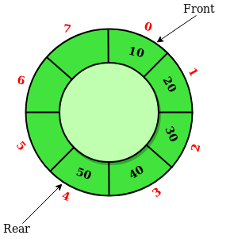
Queues: Using Circular Arrays

Slide 41
Queues: Using Circular Arrays
Operation | Description | Time complexity
enqueue(element) | Adds element to back | O(1)
dequeue( ) | Removes element from front | O(1)
peek( ) | Returns element at front | O(1)

Slide 42

Queues in real life

Slide 43
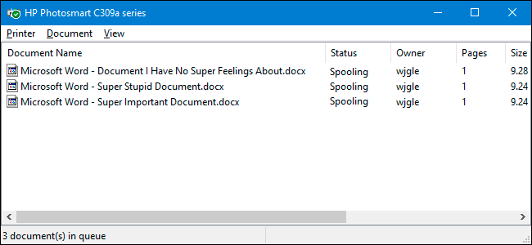
Queues in real life

Slide 44
Hash Tables
Why Hash Tables?
Implementation:
Overview
Hash functions
Collision Handling
Sets
Code time!

Slide 45
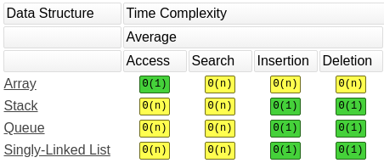
Hash Tables: the motivation
Can we get a data structure such that:

Slide 46
Hash Tables: the motivation
hashtable[“Jeff”] = “112B”
hashtable[“Elon”] = “40B”
hashtable[“Bill”] = “105B”
Jeff
Bill
Elon
hashtable["Elon"]
> 40B
112B $
105B $
40B $
del hashtable["Elon"]
hashtable["Elon"]
> Error key not found

Slide 47
How can we achieve O(1) search?

Slide 48
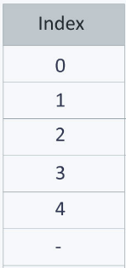
Hash Tables: Implementation
Using an array?
112B $
1. Restricted to positive integer keys
2. We may use way more memory than necessary
105B $
40B $

Slide 49
Hash Tables: Implementation
hash functions
Jeff
112B $
Bill
HASH
105B $
Elon
40B $

Slide 50
Hash Tables: Implementation
collisions
Linked List
hash(“Jeff”) == hash(“Elon”)
> 1
112B $
105B $
105B $

Slide 51
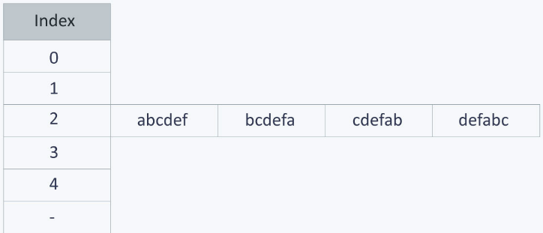
Hash Tables: Implementation
Collisions: A bad hash function
The index for a specific string will be equal to the sum of the ASCII values of the characters modulo 599
What would be the complexity of finding an element in this case?

Slide 52
Hash Tables: Implementation
Hash Sets: a special type of hash tables
Jeff
Sets do not actually contain values
A set is simply a collection of unique keys.
Bill
HASH
Elon
hashset["Elon"]
> True

Slide 53
Let’s code
Use Python's built in hash table: dictionary
Solve “Two Sum” problem

Slide 54
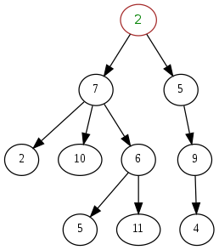
Trees

Slide 55
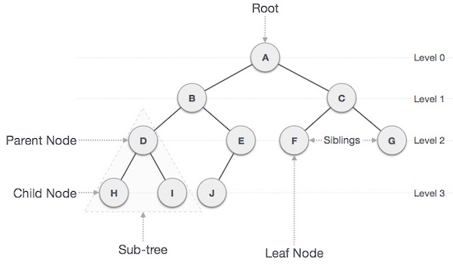
Trees: components
Root
Parent node
Child node
Sub-tree
Leaf node

Slide 56
Trees: utility
Implement other data structures(hint: hash tables)
Find the Min /Max element
Successor(v) 'next larger'
Predecessor(v) 'previous smaller element'
List elements in sorted order

Slide 57
Types of Trees

Slide 58
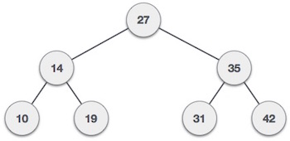
Binary Trees
Root
Max 2 child nodes

Slide 59
Binary Search Trees
All left descendants <= All right descendants
19 <= 27 <= 31
31 <= 35 <= 42
<

Slide 60
Binary Search Trees: basic operations
Insert − Inserts an element in a tree/create a tree.
Search − Searches an element in a tree.

Slide 61
Binary Search Trees: visualization
Notes:
https://www.cs.usfca.edu/~galles/visualization/BST.html

Slide 62
Binary Search Trees: traversals
Inorder: Left = > Root = > Right

Slide 63
Binary Search Trees: traversals
Preorder: Root = > Left = > Right

Slide 64
Binary Search Trees: traversals
Postorder: Left = > Right = > Root

Slide 65
Let’s code

Slide 66
Heaps
(Binary) heap is a binary tree (a tree in which each node has at most two children) which satisfies the following additional properties:
The binary tree is complete, i.e. every level except the bottom-most level is completely filled and nodes of the bottom-most level are positioned as left as possible.
One of:
Max-heap property: The key of every node is larger than or equal to its children.
Min-heap property: The key of every node is smaller than or equal to its children.

Slide 67
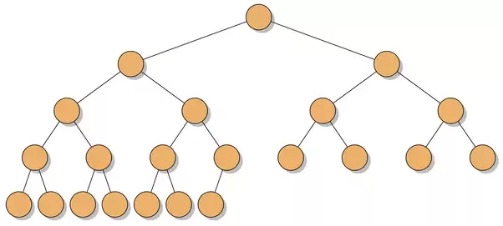
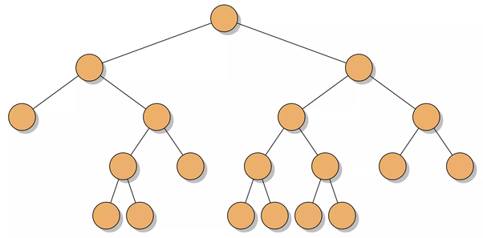
Complete Binary Tree
✅
❌

Slide 68
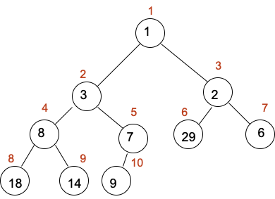
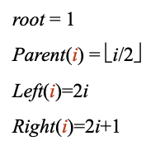

Heap Array implementation (first index at 1)

Slide 69
Operations
Operation | Description | Time complexity
push(v) | Adds v to the (max/min)-heap | O(log n)
peek( ) | Returns (max/min) element in the heap | O(1)
pop( ) | Returns and removes (max/min) element in the (max/min)-heap | O(log n)

Slide 70
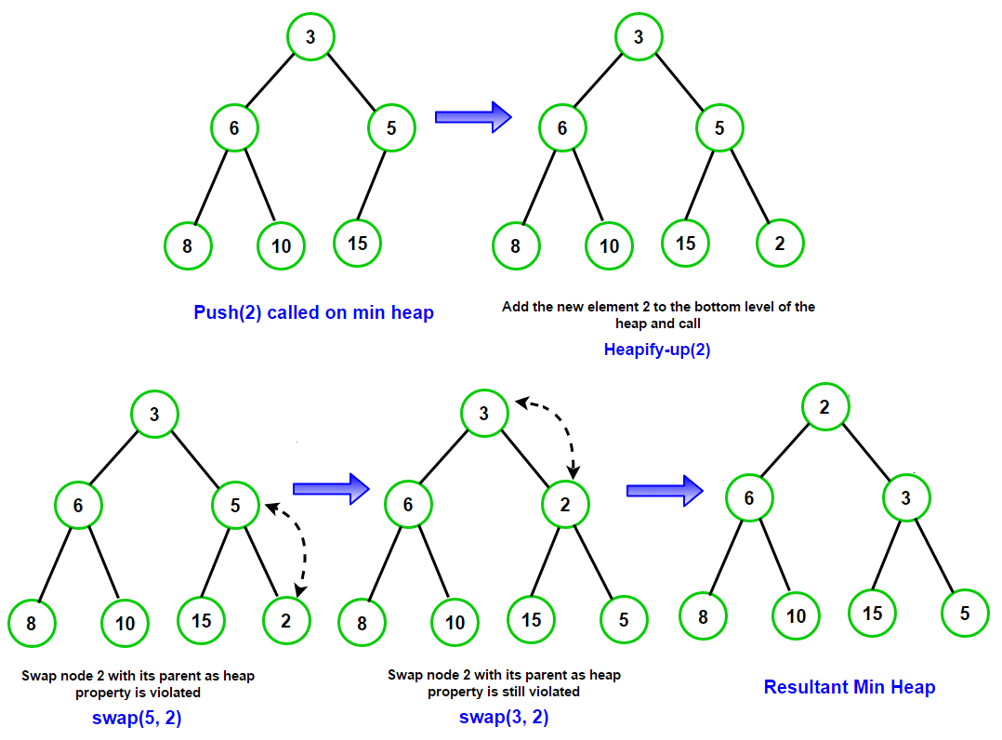
Push

Slide 71
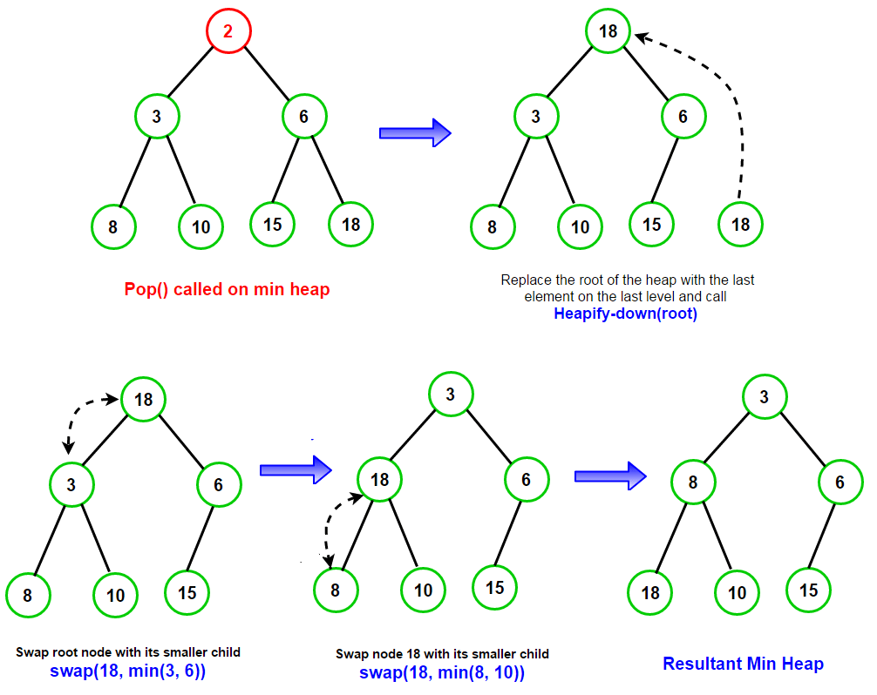
Pop

Slide 72
Let’s code
Given an array return largest kth element
Example:
Input: array [6,1,9,8,5], k =3
Output: [9,8,6]
Given a string return first k non repeating characters
Example
Input string="ADCADR" k=2
Output ["C". "R"]

Slide 73
Graphs

Slide 74
Graphs
العريضة:
شناهوما Graphs
انواع Graphs؟
كيف يمكن تمثيلها؟
كيف يمكن البحث فيها
اجيو نكوديو

Slide 75
Graphs: مقدمة
Vertice, العقدة
Graph
Trees
Edge,حافة
( Relation, distance, ressemblance, lien...)
G = (V,E)
Graphs نوع خاص من Trees

Slide 76
Graphs: خصائص
V1
V2
V8
V= {V1,V2,V3,V4,V5,V6,V7,V8}
E={{V1,V2},{V1,V8},{V1,V5},{V2,V3}{V2,V4},{V3,V6},{V4,V6},{V5,V6},{V7,V8}}
V4
V3
V5
V7
V6

Slide 77
Graphs: انواع
V1
V2
V8
V4
V5
V3
V7
V6
Directed (موجه) Graph
Undirected ( غير موجه) Graph

Slide 78
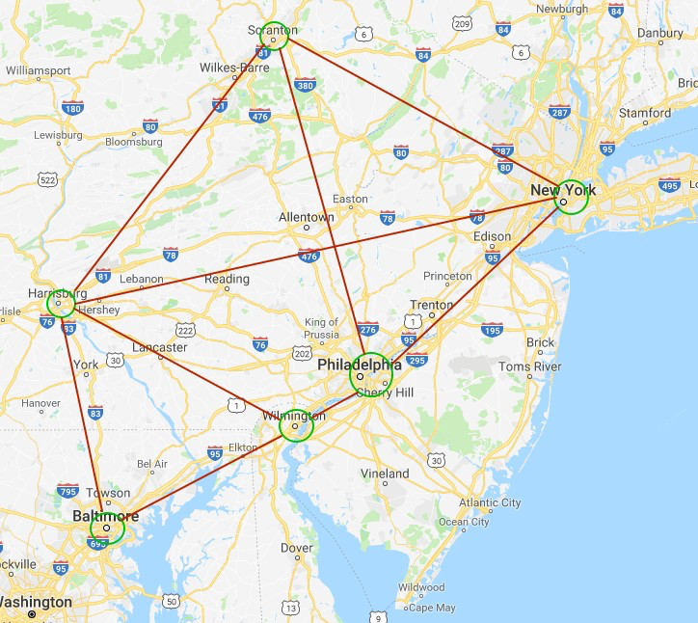
Graphs: انواع
178
300
130
300
165
300
300
Weighted (موزون) Graph
Unweighted ( غير موزون) Graph

Slide 79
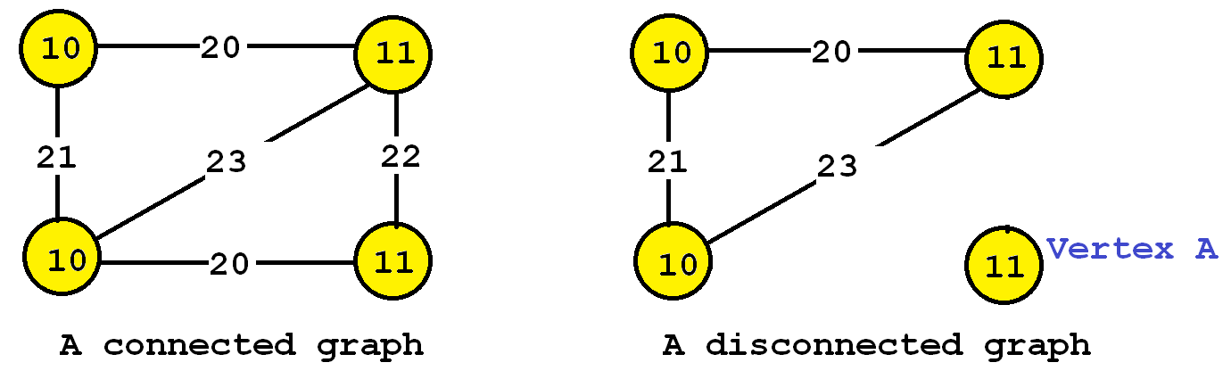
Graphs: انواع
Connected (متصل) Graph
Disconnected (غير متصل) Graph

Slide 80
Graphs representation Adjacency Matrix
2
3
i/j | 1 | 2 | 3 | 4 | 5
1 | 0 | 1 | 0 | 1 | 0
2 | 1 | 0 | 0 | 1 | 0
3 | 0 | 1 | 0 | 1 | 1
4 | 1 | 1 | 1 | 0 | 1
5 | 0 | 0 | 1 | 1 | 0
1
4
5

Slide 81
Graphs representation Adjacency List
Ressemble à Linked list
Adjacency List
vertice adjacent
Weight
vertices
5
0
1
2
3
4
5
0
1 | 3
2 | 5
3
2
3 | 2
1
1
3 | 1
2
3
8
5
4 | 4
5 | 6
4
4
6
5 | 6

Slide 82
Graph representation
Adjacency Matrix | Adjacency List
- Uses O(n^2) memory - It is fast to lookup and check for presence or absence of a specific edge between any two nodes O(1) - It is slow to iterate over all edges - It is slow to add/delete a node; a complex operation O(n^2) - It is fast to add a new edge O(1) | - Memory usage depends on the number of edges (not number of nodes), which might save a lot of memory if the adjacency matrix is sparse - Finding the presence or absence of specific edge between any two nodes is slightly slower than with the matrix O(k); where k is the number of neighbors nodes - It is fast to iterate over all edges because you can access any node neighbors directly - It is fast to add/delete a node; easier than the matrix representation - It fast to add a new edge O(1)

Slide 83
Graphs Search
BFS : BREADTH FIRST SEARCH
DFS : DEPTH FIRST SEARCH
https://visualgo.net/en/dfsbfs

Slide 84
Let’s code
https://colab.research.google.com/drive/1y6tquHPSZR27q7cFGam9gXBkn_PCdUOt?usp=sharing

Slide 85
شكراََ
دابا وقت الأسئلة و البلبلة

